Slide 1
Our Shopping Annuity Mindset
Is it available in our exclusive brands?
Is there a similar product in our exclusive brands?
Have you searched in your own shop yet?
Is there a similar product or service via our partner stores?
Let US share how we do it …

Slide 2
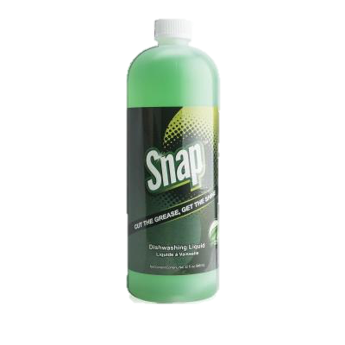
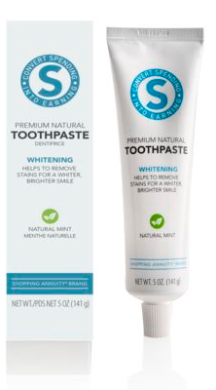
Health & Wellness
Oxygen Extreme x 2 – 28 BV
Digestive Enzymes x 2
36BV
Joint Support + 1 Fish Oil
72 BV
Probiotics x 2
40 BV
1 Aloe Juice
+ 2 Aloe Powder
41 BV
Daily Essential Kit+ 1 x OPC-3™ 131.5BV
TLS
Personal Care
Skin Care
Home Care
7.25BV
49BV
34 BV
67 BV
70 BV
TLS CLA
22 BV
TLS Trimtea
40 BV
31 BV
SNAP Triple Enzyme Detergent
– 5.25 BV
SNAP All Purpose
– 5 BV
5 BV
24 BV
Health & Wellness + TLS
410.5 BV per month
Personal / Skin & Home care
(297.5 BV upon purchase)
Avg. 99.1 BV per month
Total BV per month
509.6BV
Notes:
My wife and I are a 2 person household.
When I was first approached by my sponsor in 2014 , the first thing that came to my mind is that we could now buy our supplements from our own store and not the healthfood stores.
So what is the cornerstone of our shopping annuity? Health and wellness of course.
Lets take a look at the items we use
1.Daily essentai
2. As we take a lot of OPC we use 2 bottles of OPC3 every month
3. Eat out frequently? We take 2 bottles of digestive enzymes to ensure we get the most out of what we eat
4. Joint health is important too. 1 joint support kit a month plus an extra circumin allows us to take 1 circumin a day
5. Don’t forget your gut flora, ever had stomach upset? We take 1 tab each daily
6. Of course we take aloe – and so does one of my cats – he is a special needs cat and aloe is a natural alternative to help his bowel movement – well we do take it daily too
7. How many of you have late nights, doing our business after a full day of work – take oxygen extreme and you will have a powerful ally
Next will be TLS
To mitigate against some extras or a snack between meals we use the TLS Shake , CLA after food & core before our heavier meals.
Personal care
We always say if someone showers they can be our customers – so do we – royal spa is a given for every house hold
We have an awesome line of skin care products and we use them regualrly too.
Home care is an area we can provide too. If we don’t buy it from ourselves , where are we going to get ti from?
Do you wash your clothes?
In summary for health and wellness accounts for 455BV every month
For personal & skincare its 54.2 bv
So in total , we use 509.2BV
What are the benefits of using all these products? No1 they are some of the best available , 2nd they are part of our own store , where else should we shop at? 3rd the more you spend the faster your business grows

Slide 3
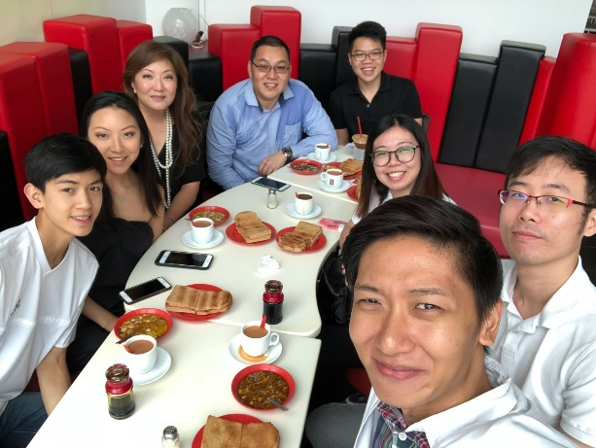
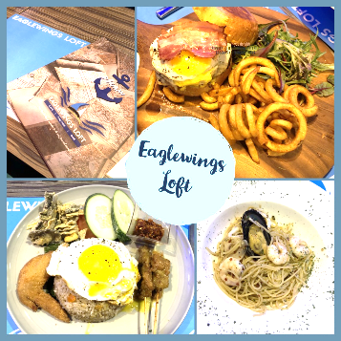
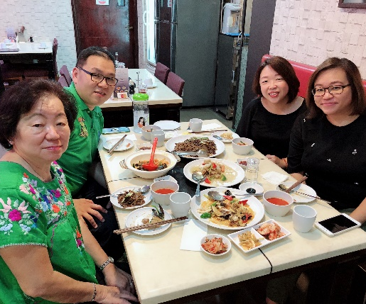
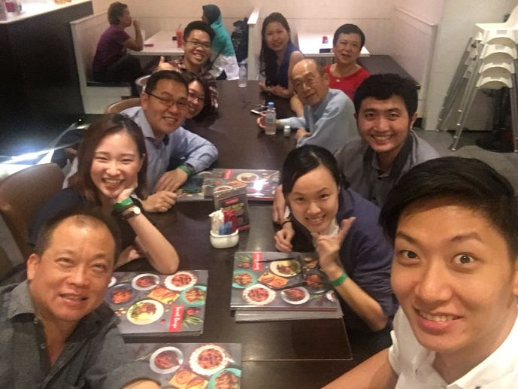
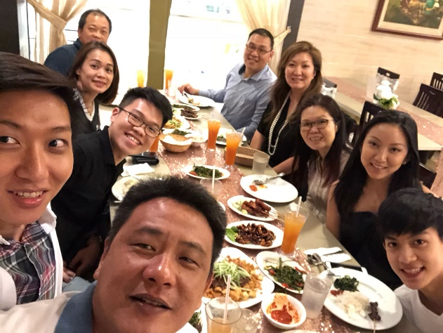
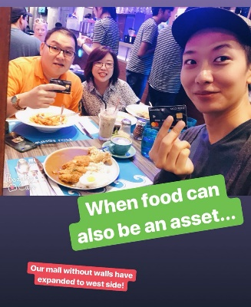
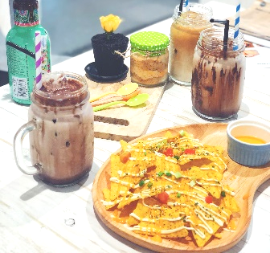
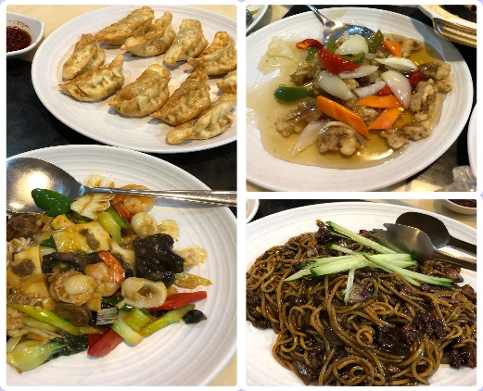
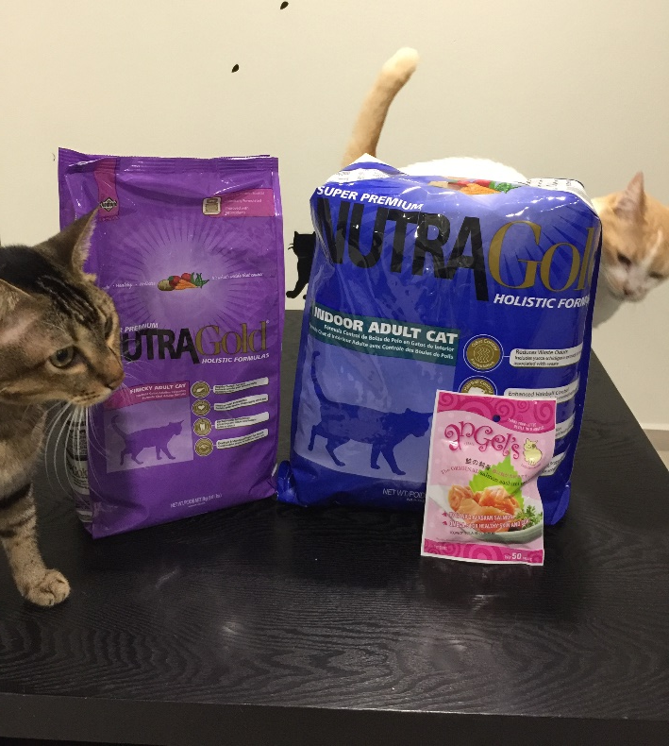
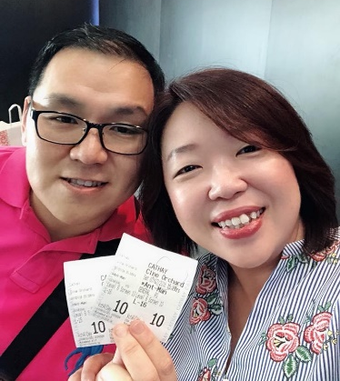
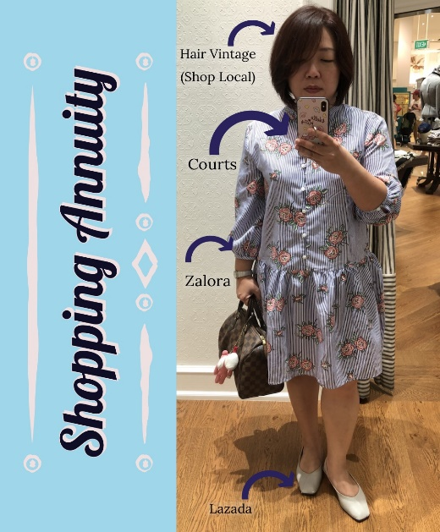
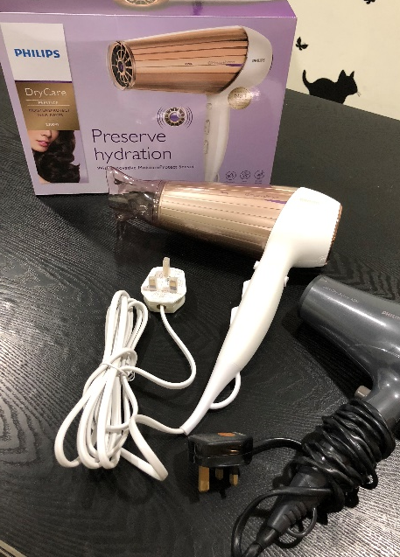
Overseas HOTELs
+ BUS RIDES
For TEAM TRIPS
Team Dinner @
Desa Kartika
Via FAVE
IBV SPENDING
What Are The Requirements?
$3,750 PER QUARTER
BREAK IT DOWN
$1,250 per month
/ $312.5 per week
Family Lunch @
Dong Fang Hong
-ShopLocal store
LIST DOWN
QUARTERLY -
Travel – personal trips / business trips
House hold upkeeping
MONTHLY EXPENSES -
Personal grooming
General well being
Fashion
Entertainment
WEEKLY HABITS
Food
Household essentials
Coring @ Yakun
Via
Klook
Eaglewings Loft & fArt tArtz ShopLocal
Groceries
Via Anchorvale Supermarket
Movie @ Cathay VIA
FAVE
Hair Dryer from bestdenki VIA Giftano
Cat Food & Cat Treats
Via Pet Food Care
Dress from Zalora

Slide 4
Our Shopping Annuity Mindset
Shop From Your Own Shop
Be A Product Of The Product
Shopping Annuity is A HABIT
YOU ARE THE OWNER OF YOUR STORE
Would You Go To Another Store To spend on A Product Or Service You Already Provide?
START TODAY & GET YOUR WHOLE TEAM PAID

Slide 5
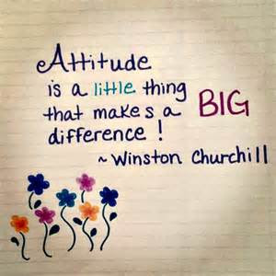

Slide 6
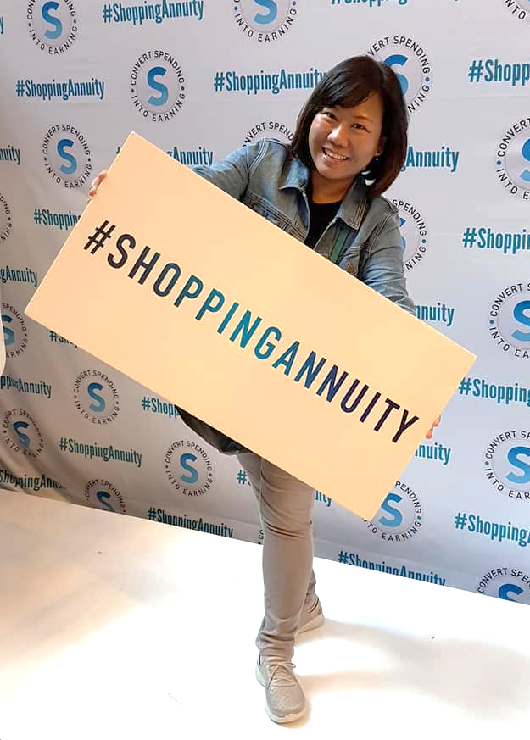
BEGINS WITH ME

Slide 7
RIGHT MINDSET
BELIEF
IN JR
IN THE COMPANY
IN THE SHOPPING ANNUITY
IN OURSELVES

Slide 8
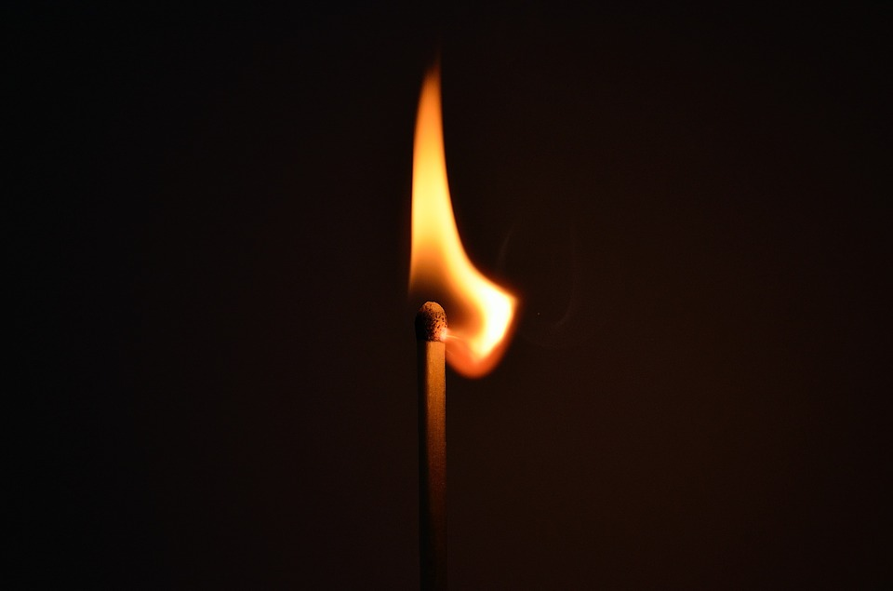
A Tiny spark can set a forest AFLAME.
BELIEVE THAT WE CAN BE THE SPARK!

Slide 9
RIGHT MINDSET
WILLINGNESS
TO CONVERT
TO EXPLORE
TO FOLLOW
TO MAKE EFFORTS
TO SHARE
TO BE INCONVENIENT
TO BE DISCIPLINED
TO TRY

Slide 10
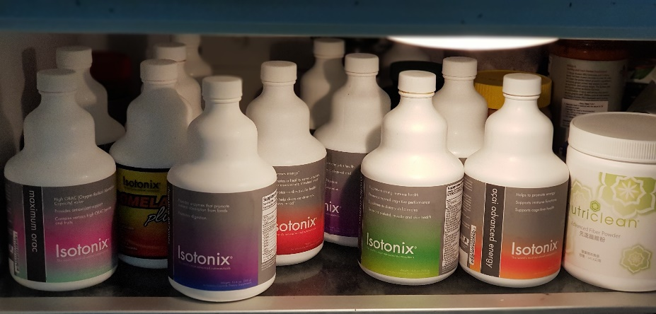
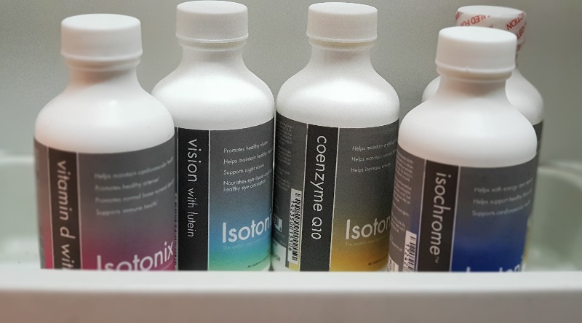
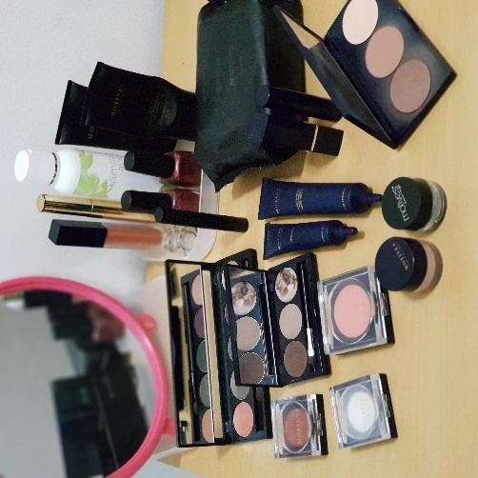
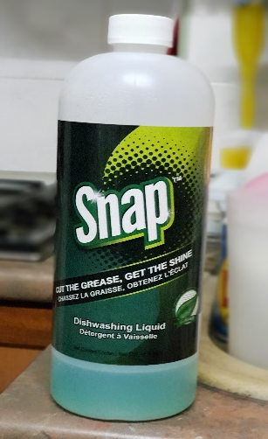
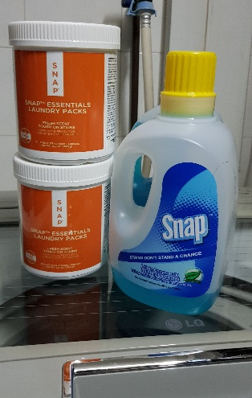
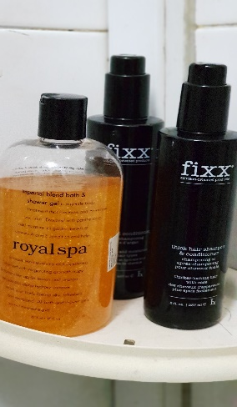
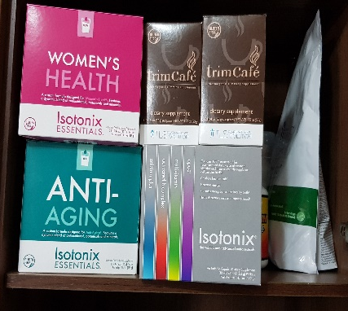
Exclusive Products
Personal Consumption

Slide 11
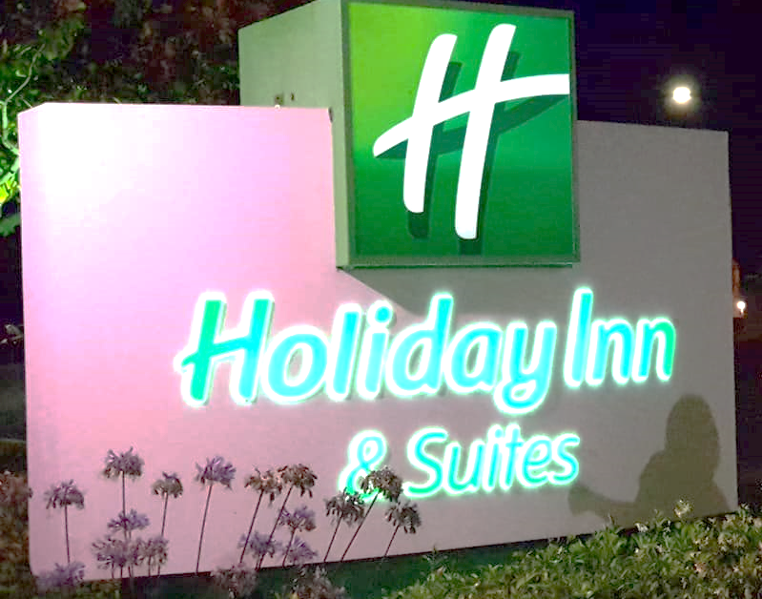
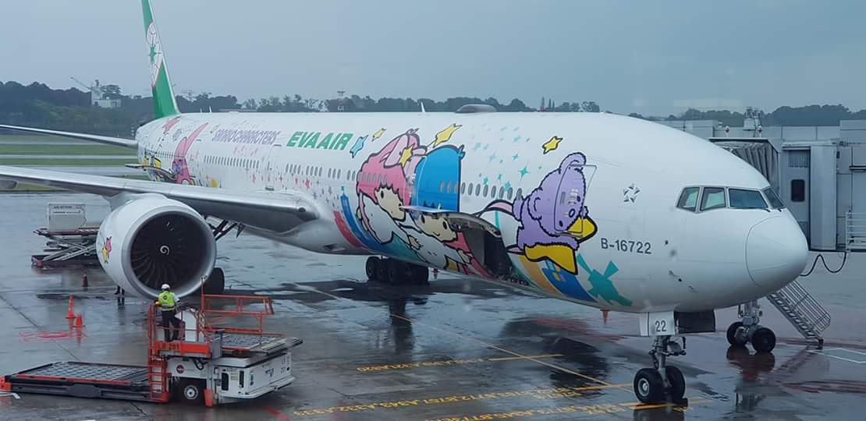
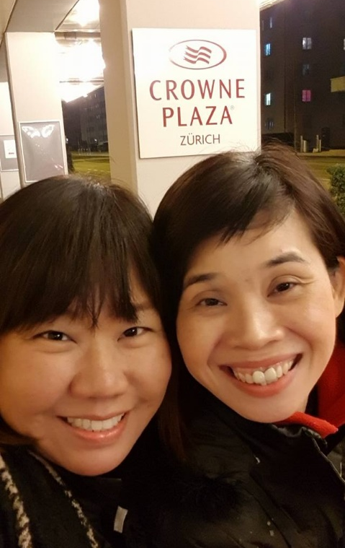
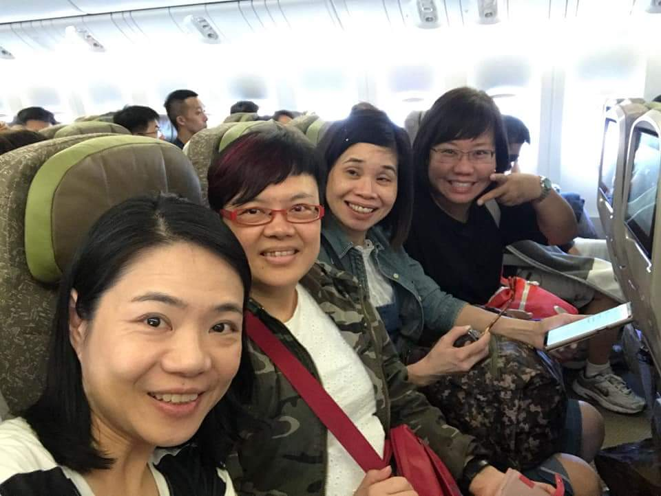
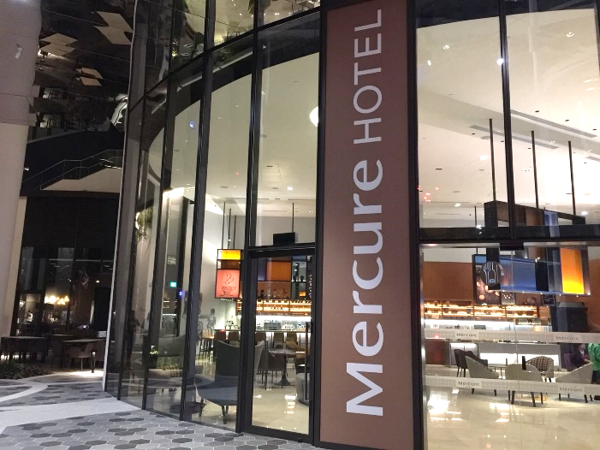
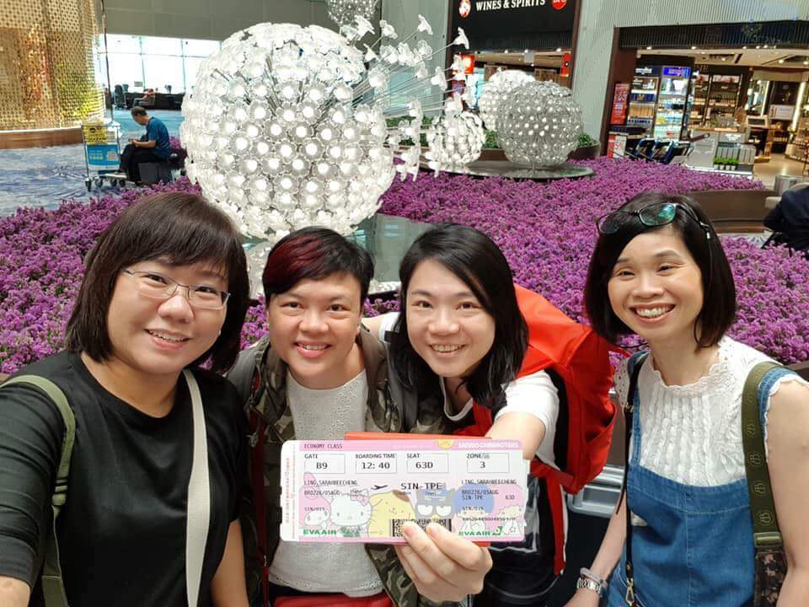
Partner Stores : Flights & Hotels

Slide 12
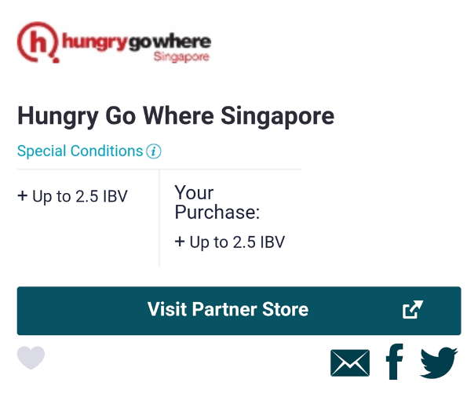
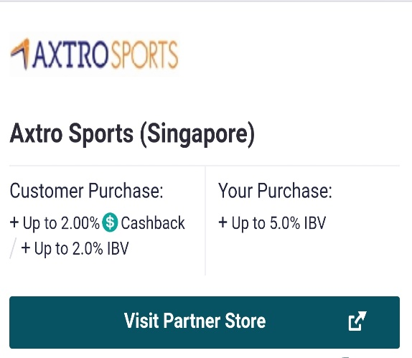
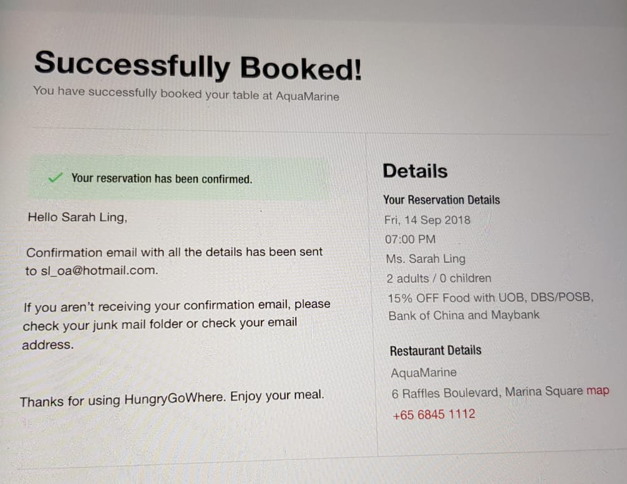
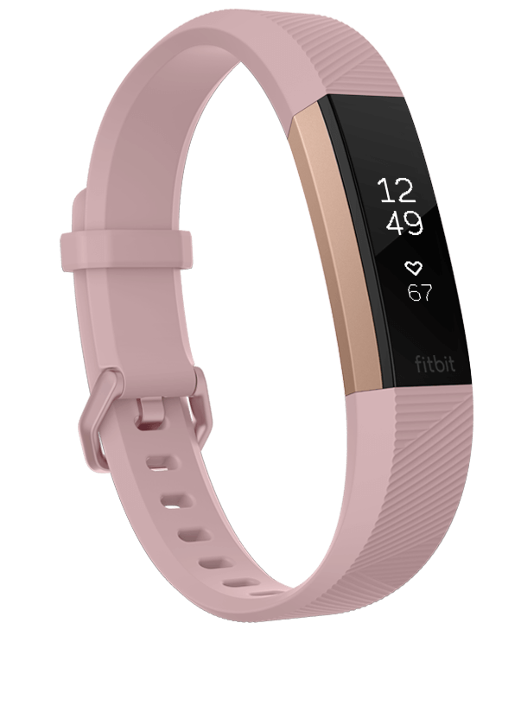
Partner Stores

Slide 13
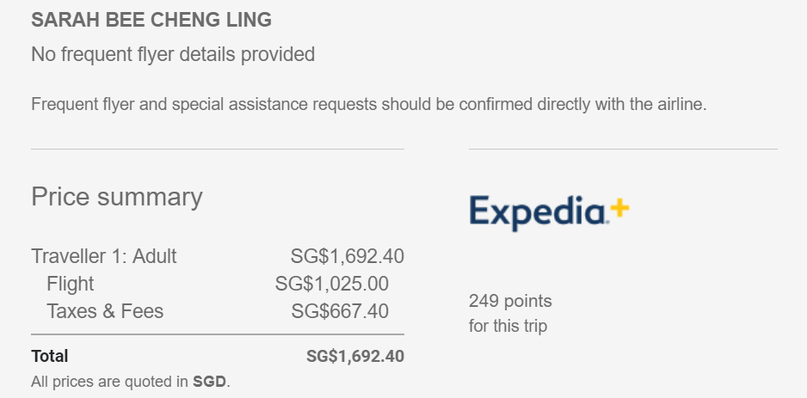
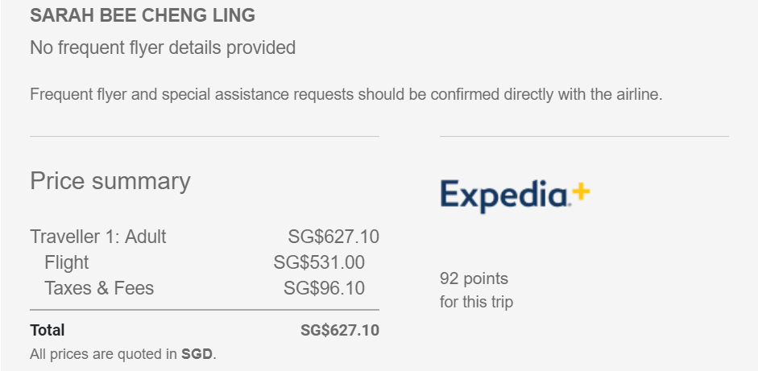
Partner Stores : Flights
$627.10
$1,692.40

Slide 14
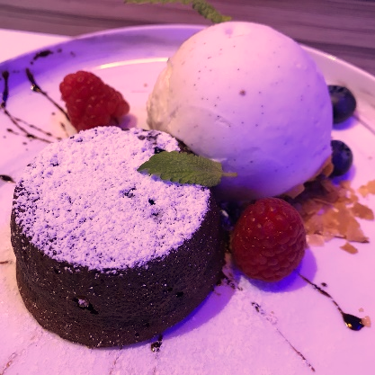
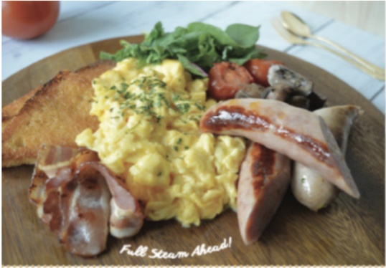
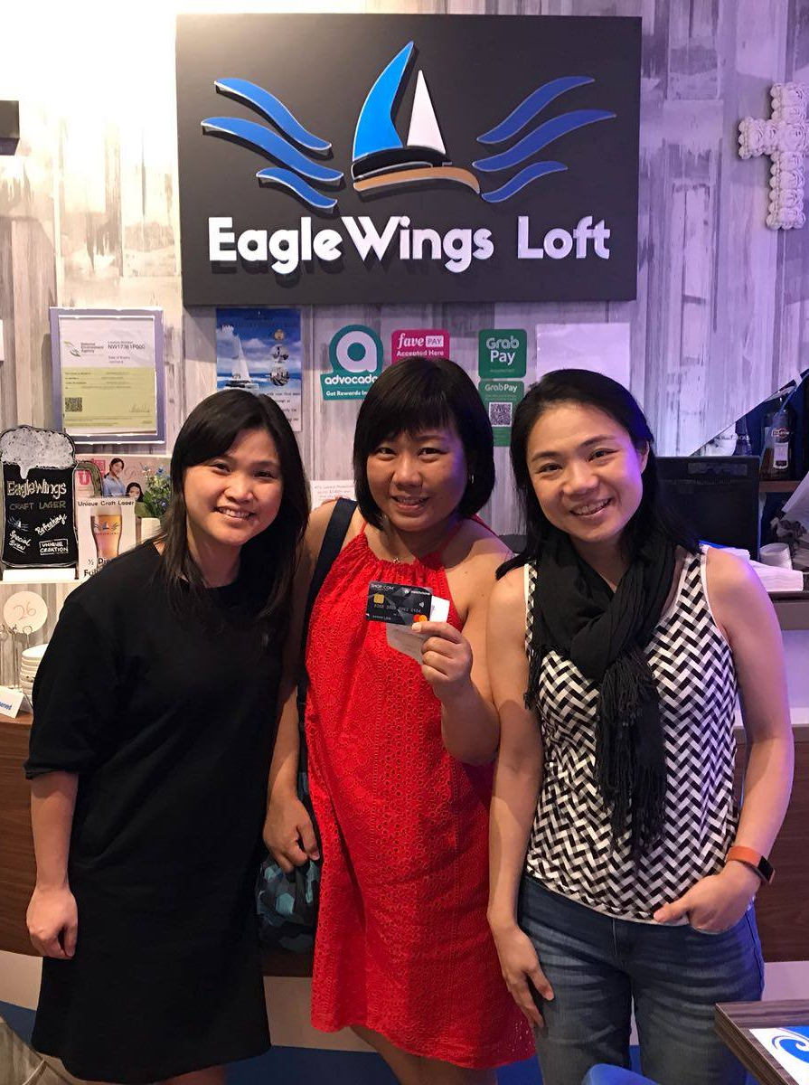
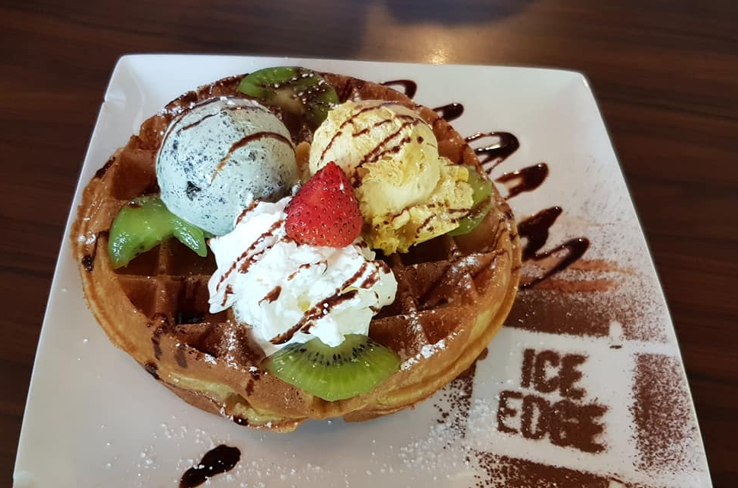
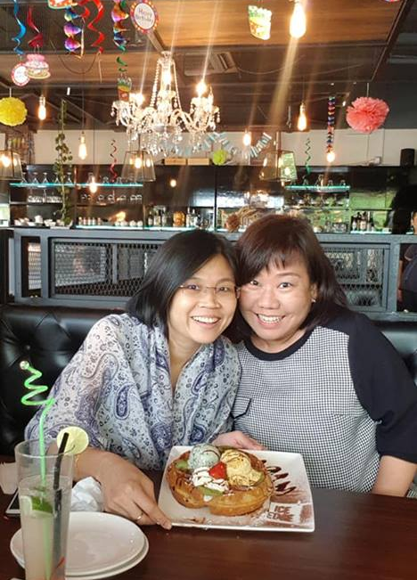
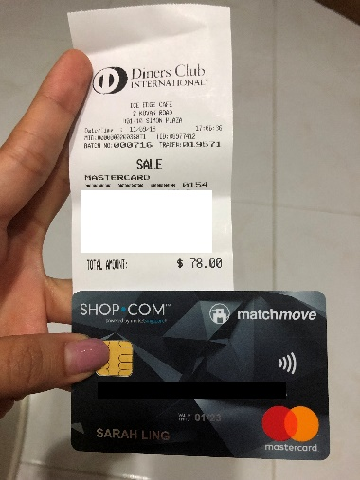
Birthdays

Slide 15
Shopping Annuity is
A revolutionary concept that allows AVERAGE, ORDINARY PEOPLE like us to create OUR OWN economy through our DAILY SPENDING and SHOPPING.- JR

Slide 16
IF YOU NEVER TRY, YOU WILL NEVER KNOW - JR
NTNK!

